Slide 1
Modeling in the Time Domain
New

Slide 2
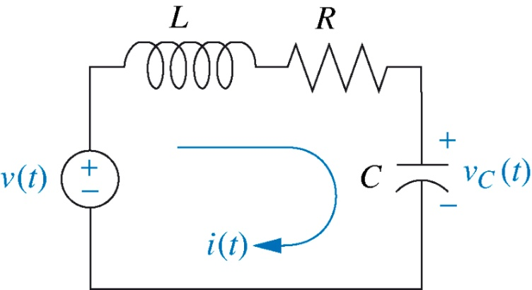

Two approaches available:
Frequency domain: converting the system differential equation to a Transfer Function (output vs. input).
Time domain: also known as state-space modeling.
Frequency domain approach is restricted to linear, time-invariant systems. While the time domain approach is more general and can deal with non-linear systems.
Example:

Slide 3

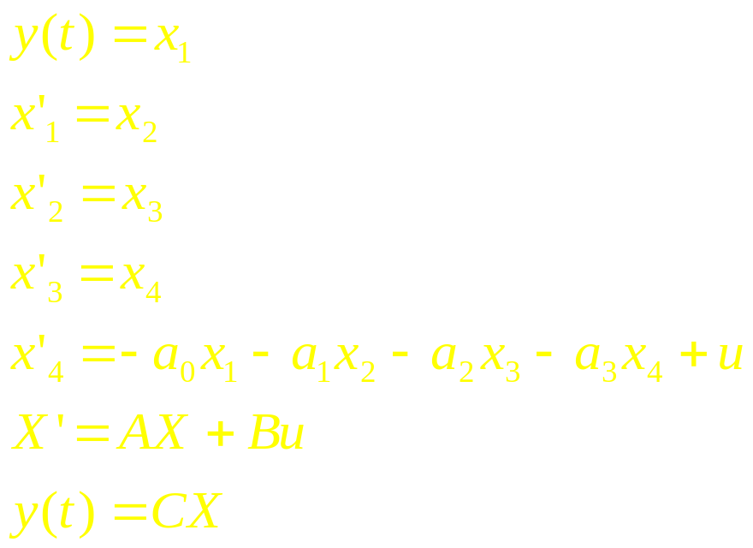
Converting High Order O.D.Es to State Space
In matrix form

Slide 4

State-Space Representation
In general an nth-order differential equation can be converted to n simultaneous first-order diff. equations. This is called the State Variable Equations.
In the previous example:

Slide 5

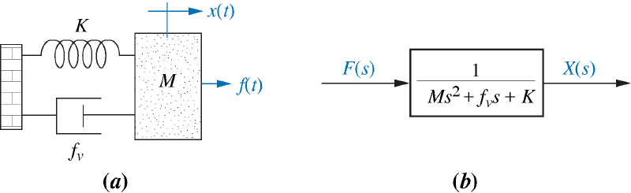

State Variable Equations

Slide 6

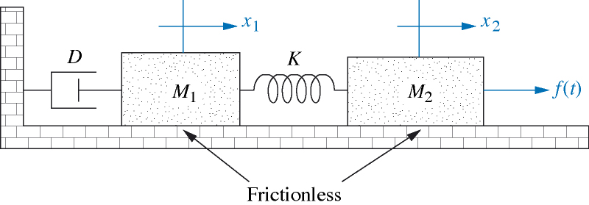
Exercise: Do example 3.3 of the Text

Slide 7
Converting a Transfer Function to State Space
Example 3.4 (Text):

Slide 8
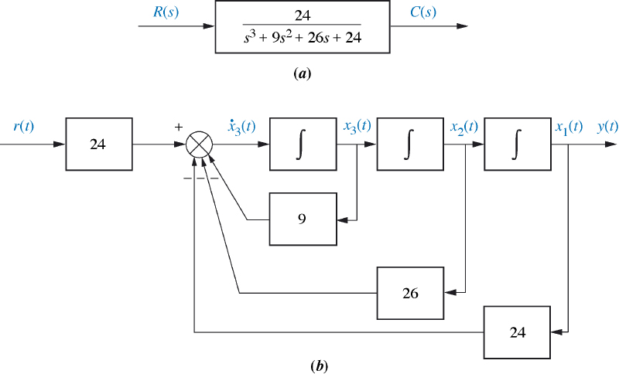
State Variable Representation

Slide 9
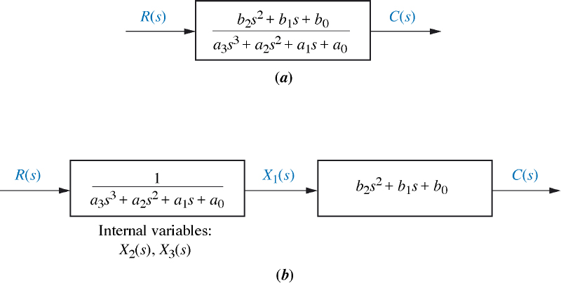
fig_03_11
Exercise: Do example 3.5 in the text
fig_03_11

Slide 10
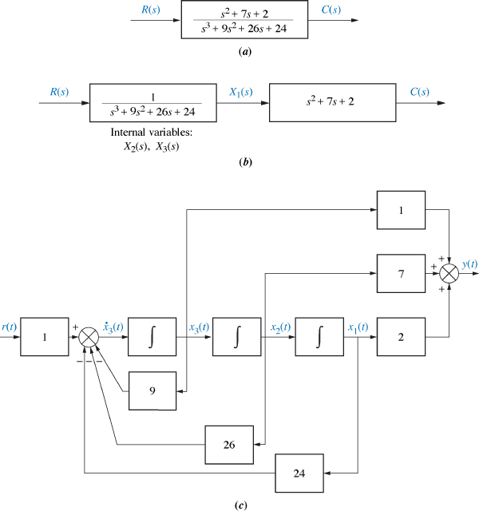
fig_03_12
fig_03_12
Students: please complete the example 3.5 in the text

Slide 11

Converting from space state to a transfer function

Slide 12
Exercise: Do example 3.6 in the Text
Students: please complete this exercise by using Matlab.

